Slide 1
Voting systems
Thinking critically with maths

Slide 2
I can understand other existing voting systems.

Slide 3
With the Single Transferable Vote (STV), the opinions in parliament match the strength of support in the country.
With the Alternative Vote (AV), your constituency gets an MP the majority support.

Slide 4

Voting systems
Single Transferable Vote (STV)
Alternative Vote (AV)

Slide 5
Single Transferable Vote (STV)
With the Single Transferable Vote (STV), the opinions in parliament match the strength of support in the country.
Rather than electing one candidate, bigger areas elect a small group of candidates.
Voters number the candidates on their ballot paper, starting with 1 for their favourite. Voters can put numbers next to as many or as few candidates as they like.

Slide 6
Single Transferable Vote (STV)
To get elected, a candidate needs to receive enough votes to reach a set value, known as the quota. The quota is based on the number of vacancies and the number of votes cast.
Each voter has one vote. If your first choice candidate reaches the quota of votes, then additional votes move to each voter’s second choice candidate.

Slide 7
Single Transferable Vote (STV)
If no candidate reaches the quota, the least popular candidate is removed and their votes are assigned to the voter’s second choice.
This process is repeated until the number of vacancies are filled.

Slide 8

Single Transferable Vote (STV)
To decide the quota required to be elected, the following formula is used:

Slide 9


Single Transferable Vote (STV)
There were 109 525 votes cast and three seats to be filled. What is the quota for the number of votes required to earn a seat?
There were 89 862 votes cast and four seats to be filled. What is the quota for the number of votes required to earn a seat?
27 382 votes are needed.
17 973 votes are needed.

Slide 10
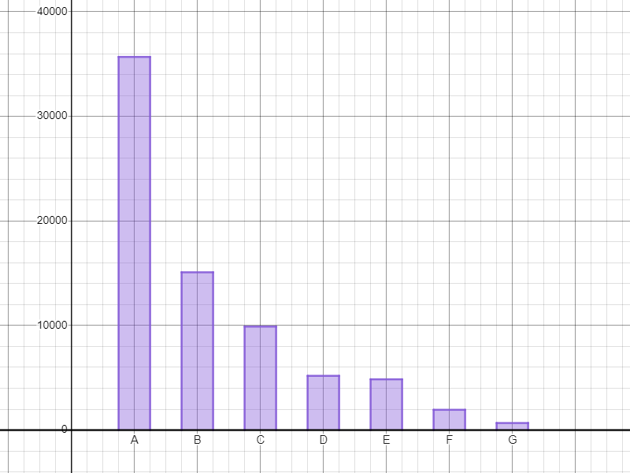
Single Transferable Vote (STV)
17 973 votes are needed and there are four seats to fill. Here is a graph showing the votes each candidate received.
Who, if anyone, has been elected?
Candidate A has been elected. They take the first seat.

Slide 11
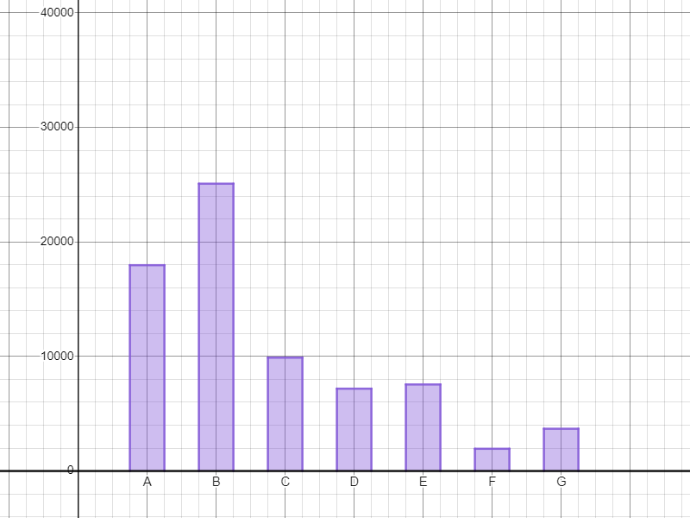
Single Transferable Vote (STV)
17 973 votes are needed and there are four seats to fill. Here is a graph showing the votes each candidate received.
After candidate A’s excess votes have been redistributed, who (if anyone) has been elected?
Candidate B has been elected. They take the second seat.
E
L
E
C
T
E
D

Slide 12
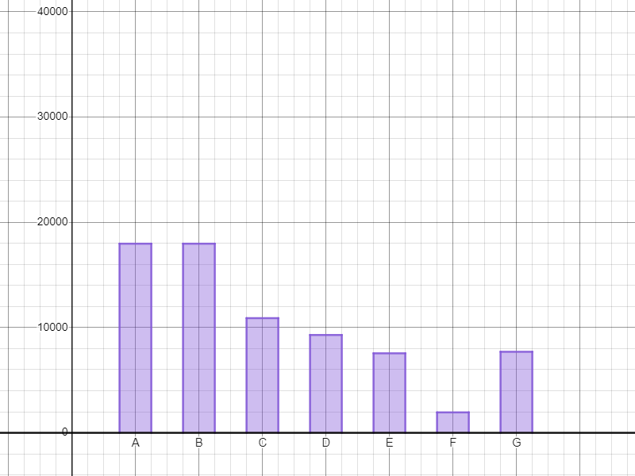
Single Transferable Vote (STV)
17 973 votes are needed and there are four seats to fill. Here is a graph showing the votes each candidate received.
After candidate B’s excess votes have been redistributed, who (if anyone) has been elected?
No one has been elected. The candidate with the least number of votes (F) is removed and their votes are reassigned.
E
L
E
C
T
E
D
E
L
E
C
T
E
D

Slide 13
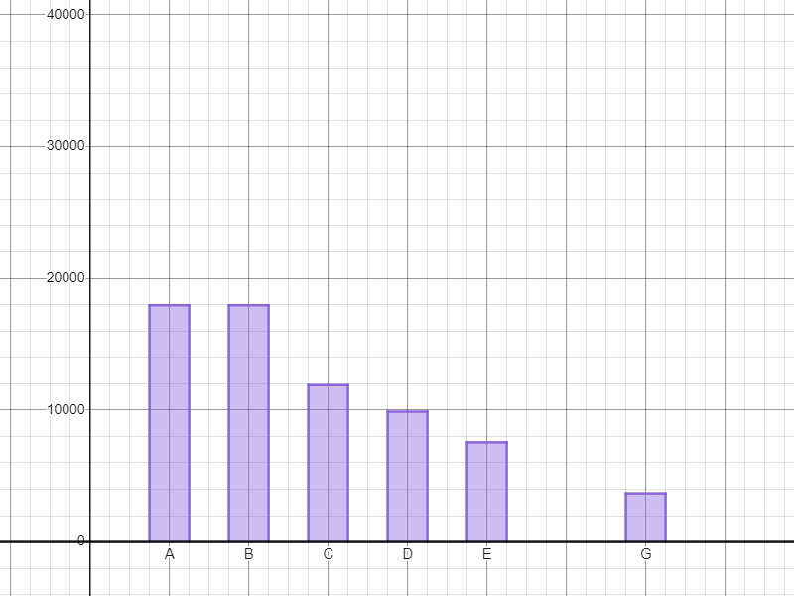
Single Transferable Vote (STV)
17 973 votes are needed and there are four seats to fill. Here is a graph showing the votes each candidate received.
There are now four candidates who are still in the running.
Who is eliminated next?
Candidate G as they have the lowest number of votes and the other three candidates have not met the quota.
E
L
E
C
T
E
D
E
L
E
C
T
E
D

Slide 14
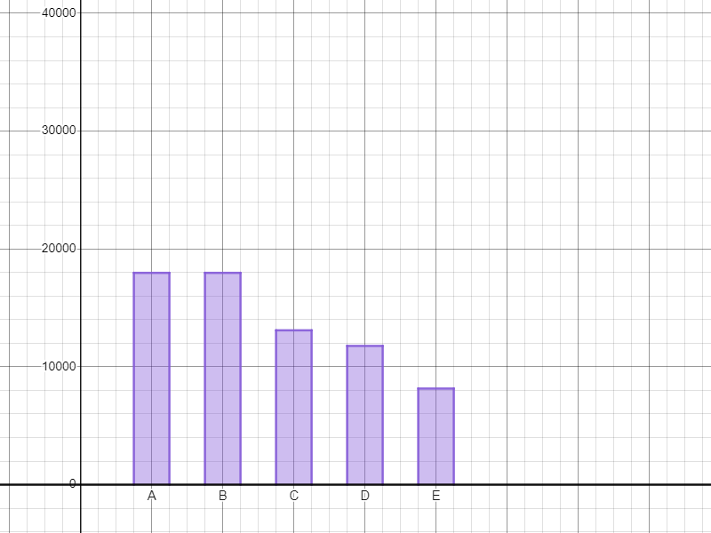
Single Transferable Vote (STV)
17 973 votes are needed and there are four seats to fill. Here is a graph showing the votes each candidate received.
What happens now?
Candidate E is eliminated. Candidates C and D are elected.
E
L
E
C
T
E
D
E
L
E
C
T
E
D

Slide 15
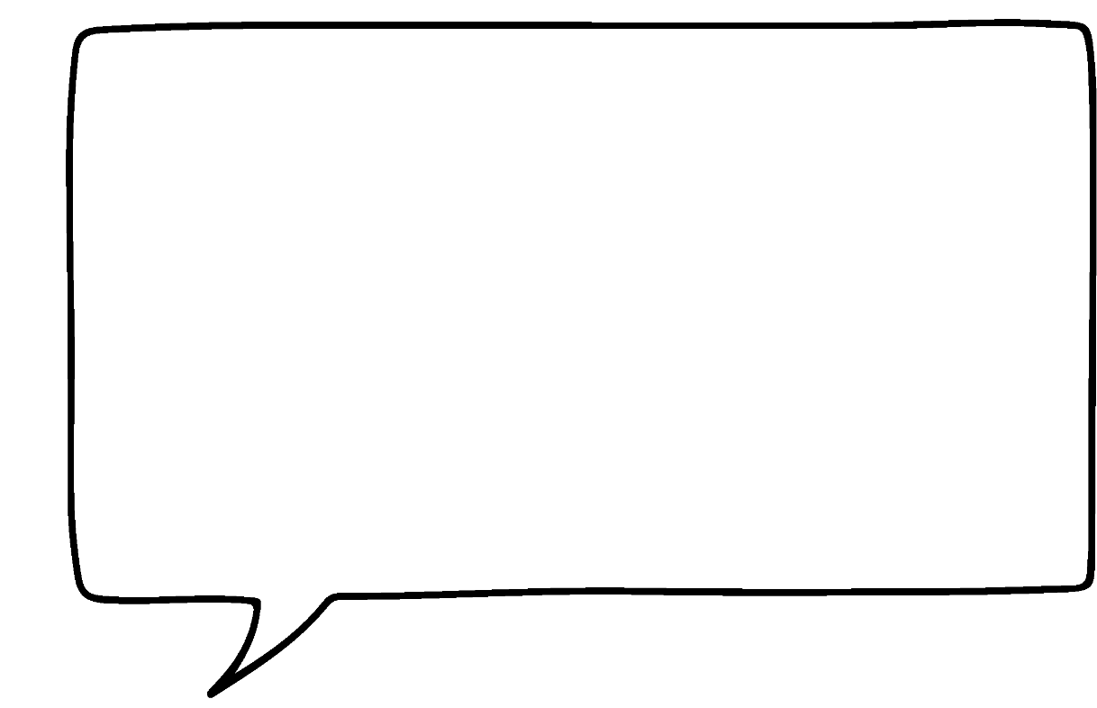

Single Transferable Vote (STV)
There are two main methods.
Random selection - the excess votes are selected randomly from all the votes a candidate received.
A candidate who received 1000 votes, but only needed 600 to win, would have 400 of their votes selected at random and reassigned.
Who decides which votes are ‘excess’ votes when a candidate reaches the quota?
Sofia

Slide 16
Single Transferable Vote (STV)
A candidate who received 1000 votes, but only needed 600 to win, would have all of their votes reassigned but each vote has a value of 400 ÷ 1000 = 0.4
There are two main methods.
Fractional transfers - the excess number is calculated and divided by the number of votes a candidate received.
Who decides which votes are ‘excess’ votes when a candidate reaches the quota?
Sofia

Slide 17

Single Transferable Vote (STV)
The quota is 18 000 votes and a candidate receives 21 000 votes. Under random selection, how many votes are reassigned?
3000
18 000
21 000

Slide 18
Single Transferable Vote (STV)
The quota is 18 000 votes and a candidate receives 21 000 votes. Under fractional transfers, how much is a reassigned vote worth?
0.14…
0.16…
0.85…

Slide 19
Single Transferable Vote (STV)
1) To decide the quota required to be elected, the following formula is used:
Calculate the quota for the following elections:
a) 12 574 votes cast and three seats to be filled.
b) 12 574 votes cast and four seats to be filled.
c) 12 574 votes cast and five seats to be filled.
2) What do you notice about the number of votes required?

Slide 20
Single Transferable Vote (STV)
3) 20 000 votes are cast in an election. There are three seats available. Here is a table showing the breakdown of the votes.
a) Calculate the quota required to win a seat.
First vote | Second vote
A: 5813 | B: 462 | C: 1068 | D: 1767 | E: 2516
B: 7820 | A: 1564 | C: 2737 | D: 539 | E: 2980
C: 1292 | A: 259 | B: 543 | D: 87 | E: 403
D: 3983 | A: 112 | B: 92 | C: 2350 | E: 1429
E: 1092 | A: 415 | B: 317 | C: 268 | D: 92

Slide 21
Single Transferable Vote (STV)
3) 20 000 votes are cast in an election. There are three seats available. Here is a table showing the breakdown of the votes.
b) Based on the first vote, who has already won a seat?
First vote | Second vote
A: 5813 | B: 462 | C: 1068 | D: 1767 | E: 2516
B: 7820 | A: 1564 | C: 2737 | D: 539 | E: 2980
C: 1292 | A: 259 | B: 543 | D: 87 | E: 403
D: 3983 | A: 112 | B: 92 | C: 2350 | E: 1429
E: 1092 | A: 415 | B: 317 | C: 268 | D: 92

Slide 22
Single Transferable Vote (STV)
3) 20 000 votes are cast in an election. There are three seats available. Here is a table showing the breakdown of the votes.
c) Assign all excess votes from any successful candidate(s) to the candidate(s) who were the most popular second vote.
First vote | Second vote
A: 5813 | B: 462 | C: 1068 | D: 1767 | E: 2516
B: 7820 | A: 1564 | C: 2737 | D: 539 | E: 2980
C: 1292 | A: 259 | B: 543 | D: 87 | E: 403
D: 3983 | A: 112 | B: 92 | C: 2350 | E: 1429
E: 1092 | A: 415 | B: 317 | C: 268 | D: 92

Slide 23
Single Transferable Vote (STV)
3) 20 000 votes are cast in an election. There are three seats available. Here is a table showing the breakdown of the votes.
d) Who has won the final seat?
First vote | Second vote
A: 5813 | B: 462 | C: 1068 | D: 1767 | E: 2516
B: 7820 | A: 1564 | C: 2737 | D: 539 | E: 2980
C: 1292 | A: 259 | B: 543 | D: 87 | E: 403
D: 3983 | A: 112 | B: 92 | C: 2350 | E: 1429
E: 1092 | A: 415 | B: 317 | C: 268 | D: 92

Slide 24
Single Transferable Vote (STV)
1) To decide the quota required to be elected, the following formula is used:
Calculate the quota for the following elections:
a) 12 574 votes cast and three seats to be filled. 3145 votes
b) 12 574 votes cast and four seats to be filled. 2516 votes
c) 12 574 votes cast and five seats to be filled. 2097 votes
2) What do you notice about the number of votes required?

Slide 25
Single Transferable Vote (STV)
1)
a) 12 574 votes cast and three seats to be filled. 3145 votes
b) 12 574 votes cast and four seats to be filled. 2516 votes
c) 12 574 votes cast and five seats to be filled. 2097 votes
2) What do you notice about the number of votes required?
As the number of seats available increases, the number of votes required to reach the quota (get elected) decreases.

Slide 26
Single Transferable Vote (STV)
3) 20 000 votes are cast in an election. There are three seats available. Here is a table showing the breakdown of the votes.
a) Calculate the quota required to win a seat.
5001
First vote | Second vote
A: 5813 | B: 462 | C: 1068 | D: 1767 | E: 2516
B: 7820 | A: 1564 | C: 2737 | D: 539 | E: 2980
C: 1292 | A: 259 | B: 543 | D: 87 | E: 403
D: 3983 | A: 112 | B: 92 | C: 2350 | E: 1429
E: 1092 | A: 415 | B: 317 | C: 268 | D: 92

Slide 27
Single Transferable Vote (STV)
3) 20 000 votes are cast in an election. There are three seats available. Here is a table showing the breakdown of the votes.
b) Based on the first vote, who has already won a seat?
Candidates A and B have both won seats as their vote total is over 5001
First vote | Second vote
A: 5813 | B: 462 | C: 1068 | D: 1767 | E: 2516
B: 7820 | A: 1564 | C: 2737 | D: 539 | E: 2980
C: 1292 | A: 259 | B: 543 | D: 87 | E: 403
D: 3983 | A: 112 | B: 92 | C: 2350 | E: 1429
E: 1092 | A: 415 | B: 317 | C: 268 | D: 92

Slide 28
Single Transferable Vote (STV)
3) 20 000 votes are cast in an election. There are three seats available. Here is a table showing the breakdown of the votes.
c) Assign all excess votes from any successful candidate(s) to the candidate(s) who were the most popular second vote. E = 4723
First vote | Excess | Second vote
A: 5813 | 812 | B: 462 | C: 1068 | D: 1767 | E: 2516
B: 7820 | 2819 | A: 1564 | C: 2737 | D: 539 | E: 2980
C: 1292 |  | A: 259 | B: 543 | D: 87 | E: 403
D: 3983 |  | A: 112 | B: 92 | C: 2350 | E: 1429
E: 1092 |  | A: 415 | B: 317 | C: 268 | D: 92

Slide 29
Single Transferable Vote (STV)
3) 20 000 votes are cast in an election. There are three seats available. Here is a table showing the breakdown of the votes.
d) Who has won the final seat?
Candidate E has won the final seat as C would now be eliminated.
First vote | Second vote
A: 5813 5001 | B: 462 | C: 1068 | D: 1767 | E: 2516
B: 7820 5001 | A: 1564 | C: 2737 | D: 539 | E: 2980
C: 1292 | A: 259 | B: 543 | D: 87 | E: 403
D: 3983 | A: 112 | B: 92 | C: 2350 | E: 1429
E: 1092 4723 | A: 415 | B: 317 | C: 268 | D: 92

Slide 30
Voting systems
Single Transferable Vote (STV)
Alternative Vote (AV)

Slide 31
Alternative Vote (AV)
With the Alternative Vote (AV), your constituency gets an MP the majority support.
Voters put a number by each candidate (one for their first choice, two for their second choice etc). They can assign a number to every candidate or just some.

Slide 32
Alternative Vote (AV)
If more than half of the voters have the same favourite candidate, that person gets elected.
If no candidate has more than half the vote, the candidate with the fewest votes is removed and their votes are reassigned, based on voters’ second choice.
This process is repeated until a candidate is elected.

Slide 33
Alternative Vote (AV)
73 345 votes are cast. Under the AV system, how many votes does a candidate need in order to win?
36 672
36 673
73 345

Slide 34
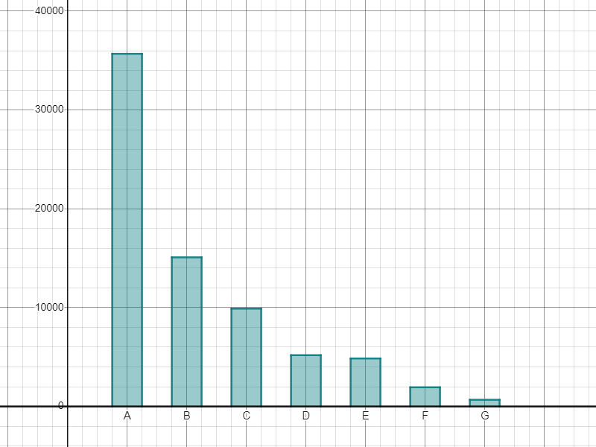
Alternative Vote (AV)
73 345 votes are cast. The horizontal line shows the number of votes required to win.
Who is removed from the election and has their votes reassigned?
Candidate G is removed and their votes are reassigned.

Slide 35
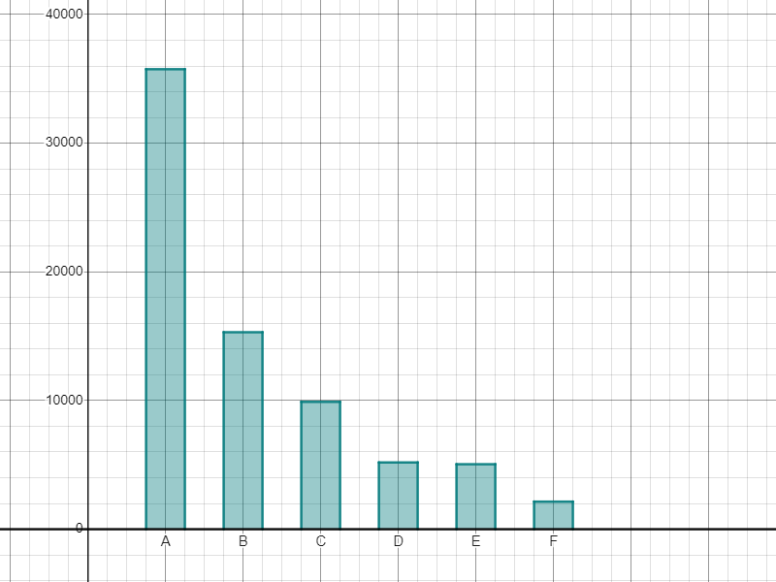
Alternative Vote (AV)
73 345 votes are cast. The horizontal line shows the number of votes required to win.
Do we have a winner?
Who do you think will be eliminated next?
No - candidate F is now eliminated and their votes reassigned.
Either D or E depending on where F’s reassigned votes go.

Slide 36
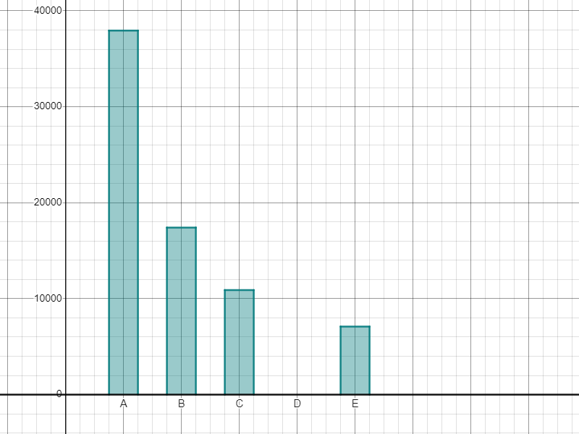
Alternative Vote (AV)
73 345 votes are cast. The horizontal line shows the number of votes required to win.
After F’s votes were reassigned, another candidate was eliminated. Which candidate was it?
Who has won the election?
D - they have no votes so these must have been reassigned.
Candidate A has won the election.

Slide 37
Alternative Vote (AV)
1) 20 000 votes are cast in an election. Here is a table showing the breakdown of the votes.
a) How many votes are required to win the seat?
First vote | Second vote
A: 5813 | B: 462 | C: 1068 | D: 1767 | E: 2516
B: 7820 | A: 1564 | C: 2737 | D: 539 | E: 2980
C: 1292 | A: 259 | B: 543 | D: 87 | E: 403
D: 3983 | A: 112 | B: 92 | C: 2350 | E: 1429
E: 1092 | A: 415 | B: 317 | C: 268 | D: 92

Slide 38
Alternative Vote (AV)
1) 20 000 votes are cast in an election. Here is a table showing the breakdown of the votes.
b) Since no one has over half the vote, which candidate is eliminated?
First vote | Second vote
A: 5813 | B: 462 | C: 1068 | D: 1767 | E: 2516
B: 7820 | A: 1564 | C: 2737 | D: 539 | E: 2980
C: 1292 | A: 259 | B: 543 | D: 87 | E: 403
D: 3983 | A: 112 | B: 92 | C: 2350 | E: 1429
E: 1092 | A: 415 | B: 317 | C: 268 | D: 92

Slide 39
Alternative Vote (AV)
1) 20 000 votes are cast in an election. Here is a table showing the breakdown of the votes.
c) Assign the votes accordingly and produce an updated table.
d) Which candidate(s) can win the election? Justify your answer.
First vote | Second vote
A: 5813 | B: 462 | C: 1068 | D: 1767 | E: 2516
B: 7820 | A: 1564 | C: 2737 | D: 539 | E: 2980
C: 1292 | A: 259 | B: 543 | D: 87 | E: 403
D: 3983 | A: 112 | B: 92 | C: 2350 | E: 1429
E: 1092 | A: 415 | B: 317 | C: 268 | D: 92

Slide 40
Alternative Vote (AV)
1) 20 000 votes are cast in an election. Here is a table showing the breakdown of the votes.
a) How many votes are required to win the seat?
Over 10 000 (10 001 or more votes.)
First vote | Second vote
A: 5813 | B: 462 | C: 1068 | D: 1767 | E: 2516
B: 7820 | A: 1564 | C: 2737 | D: 539 | E: 2980
C: 1292 | A: 259 | B: 543 | D: 87 | E: 403
D: 3983 | A: 112 | B: 92 | C: 2350 | E: 1429
E: 1092 | A: 415 | B: 317 | C: 268 | D: 92

Slide 41
Alternative Vote (AV)
1) 20 000 votes are cast in an election. Here is a table showing the breakdown of the votes.
b) Since no one has over half the vote, which candidate is eliminated? Candidate E
First vote | Second vote
A: 5813 | B: 462 | C: 1068 | D: 1767 | E: 2516
B: 7820 | A: 1564 | C: 2737 | D: 539 | E: 2980
C: 1292 | A: 259 | B: 543 | D: 87 | E: 403
D: 3983 | A: 112 | B: 92 | C: 2350 | E: 1429
E: 1092 | A: 415 | B: 317 | C: 268 | D: 92

Slide 42
Alternative Vote (AV)
1) 20 000 votes are cast in an election. Here is a table showing the breakdown of the votes.
c) Assign the votes accordingly and produce an updated table.
Vote count
A: 6228
B: 8137
C: 1560
D: 4075

Slide 43
Alternative Vote (AV)
1) 20 000 votes are cast in an election. Here is a table showing the breakdown of the votes.
d) Which candidate(s) can win the election? Justify your answer.
Vote count
A: 6228
B: 8137
C: 1560
D: 4075
In the next round, candidate C will be eliminated.
Even if all their votes go to candidate D, candidate D would only have 5635 votes, which means they would be eliminated next.
Depending on where the votes from eliminated candidates go, either A or B could still win.

Slide 44
Voting systems
With the Single Transferable Vote (STV), the opinions in parliament match the strength of support in the country.
With the Alternative Vote (AV), your constituency gets an MP the majority support.

Slide 45

© Oak National Academy 2024.
Produced in partnership with Mathematics in Education and Industry.
Licensed on the Open Government Licence v3.0, except where otherwise stated. See Oak terms and conditions.

